Slide 1
YouTube Trends Report
Nov 17` – June 18`
Sterling & Draper
Tableau Dashboard Link:
https://public.tableau.com/app/profile/jonathan.chan5881/viz/YoutubeTrendsDashboard/Dashboard1?publish=yes

Slide 2
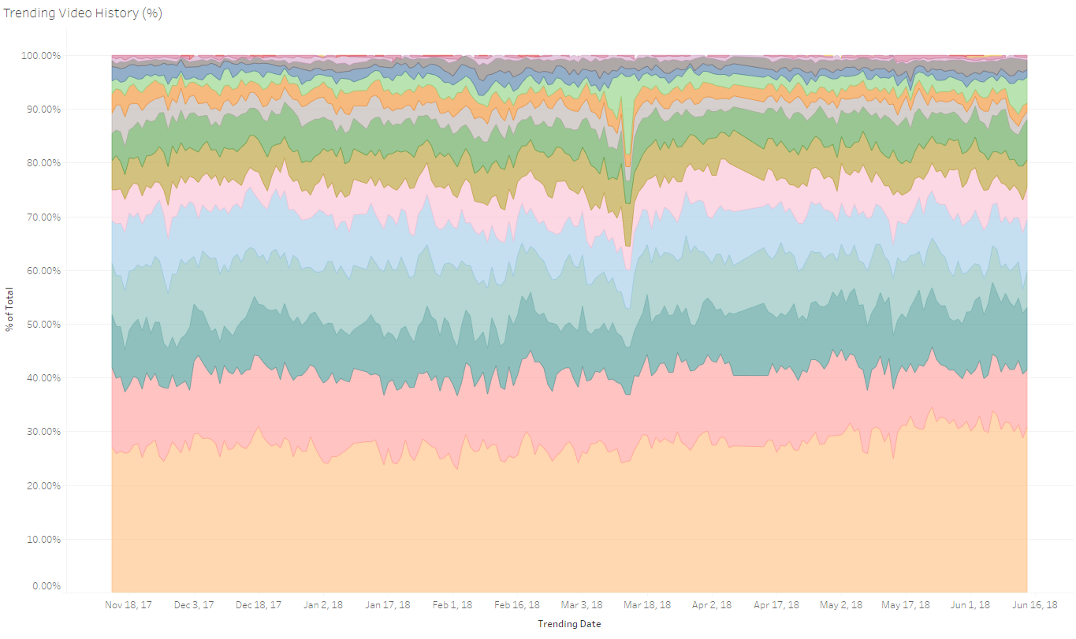
Highest Trending Video Categories
Across our time period, categories of (1) Entertainment, (2) People & Blogs, (3) Music, (4) News & Politics and (5) Comedy in that order are consistently assume the title of highest trending categories in YouTube, amounting to roughly 70% of total video categories. The major outlier here is Entertainment, which on its own accounts for about 28% of total volume across video categories.

Slide 3
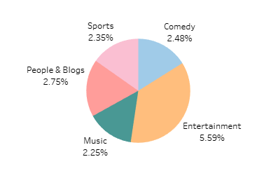
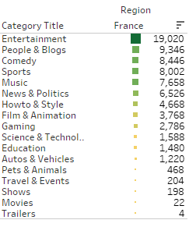
Top Video Categories by Country - France
In France, our top 5 categories are similar to our overall top 5 trends, apart from Sports replacing News & Politics. Entertainment yet again proved to be the runaway leader amongst all categories.
Top 3: Entertainment, People& Blogs, Comedy

Slide 4
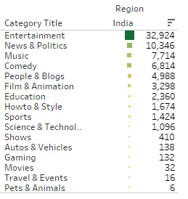
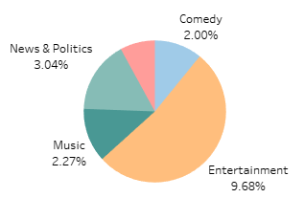
Top Video Categories by Country - India
In India, our top 5 categories are similar to our overall top 5 trends, bar the order of distribution. Yet again, Entertainment comes our on top by a staggering margin.
TOP 3: Entertainment, News & Politics, Music

Slide 5
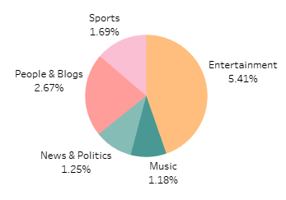
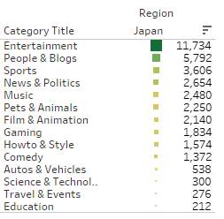
Top Video Categories by Country - Japan
In Japan, Sports replaces Comedy in our top 5, with an otherwise similar distribution of trending categories with our overall top 5 trends. Surprisingly, the percentage distribution share of Comedy videos are contrastingly low compared to our other countries and overall trends.
TOP 3: Entertainment, People & Blogs, Sports

Slide 6
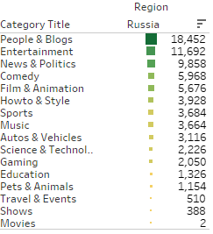
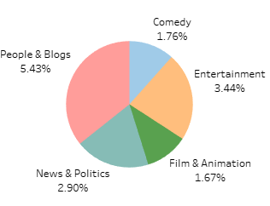
Top Video Categories by Country - Russia
In Russia, things look a bit different. Instead of Music, Film & Animation replaces it in our top 5. Moreover, while Entertainment still adopts a large share of distribution, the category of People & Blogs assumes our top spot for the first time.
TOP 3: People & Blogs, Entertainment, News & Politics

Slide 7
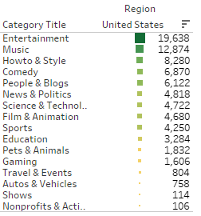
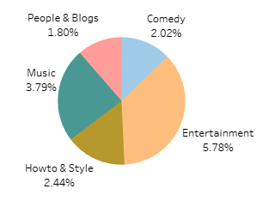
Top Video Categories by Country – United States
In the United States, there is a very cultural nuance regarding its popular categories compared to other countries. There is more lifestyle and leisure-based categories in its top 5. Apart from Entertainment, most of our countries top 3 categories comprised of at least one of People & Blogs or News & Politics. With regards to the US, our top 3 comprises Entertainment, Music and Howto & Style.
TOP 3: Entertainment, Music, Howto & Style

